Slide 1
The Big Fit project
Presented By:
Yi Zhuang
Serena Villacorta
Alaa Alhiadari
Seher Mumtaz
IST-303
Professor:
Dr. Wallace Chipidza

Slide 2
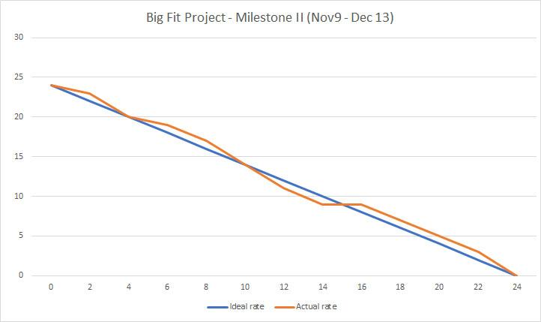
BurnDown Chart - II
Milestone II
Total Days of work =
23 days (Nov 9 - Dec 13,
Thanksgiving days)
Velocity = 30% or 0.3
4 * 20 * 0.3 = 24
Is the amount of work to be completed

Slide 3

GUI & Logo

Slide 4
New Views
Customers are able to edit their profile and change the password.
Customers are able to delete and edit weight information.
Add new feature: calorie .
Customers are able to delete and edit calorie information.
Add new features related on weight: BMI and weight status.
Customers are able to see weight/calorie history in line carts.

Slide 5
Model Update
Added calorie tracker
Functions to return BMI and Weight Status

Slide 6
SMS messaging capabilities
SMS weight input reminders

Slide 7
Pytest
Test_environment
Test_models
Test_url
Test_view

